Slide 1



Qlik Sense
A powerful BI tool for visualization data
Presenter: TengSiong (TS) Yeap

Slide 2
What is Qlik Sense
Qlik Sense is a smart and user-friendly analytics tools that can generate personalized reports and very detailed dashboards in an instant.
The first place in this category is held by Sisense which has a total score of 9.7/10 and is the winner of our Best Business Intelligence Software Award for 2018.

Slide 3
Qlik Sense - Features
Drag-and-drop visualizations
Smart Search feature
Fast and reliable connections to multiple data sources
Access to real-time analytics anytime, anywhere
Data storytelling functionality
Self-service simplicity
Shared Object Library
Progressive Creation
Managed Data Connections
Rapid Development Environment
Powerful Open and Standard APIs
Multi-source data integration including big data
Manageability
Enterprise-level security
Scalability

Slide 4
Features Comparison (Qlik Sense vs ggplot2
Qlik Sense
ggplot2
load a lot of data into the tool, create a dashboard/report and then you can do live-filtering
easy to integrate in the enterprise
R allows you to build custom coded visualizations / reports which answer 'exactly' the business questions.

Slide 5
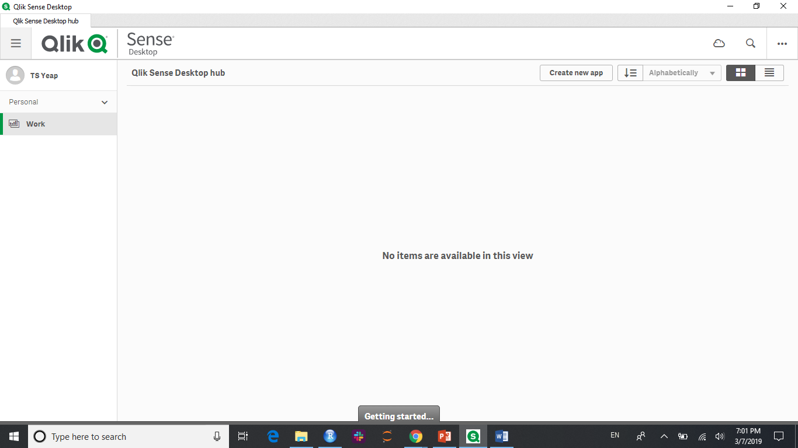
Demo

Slide 6
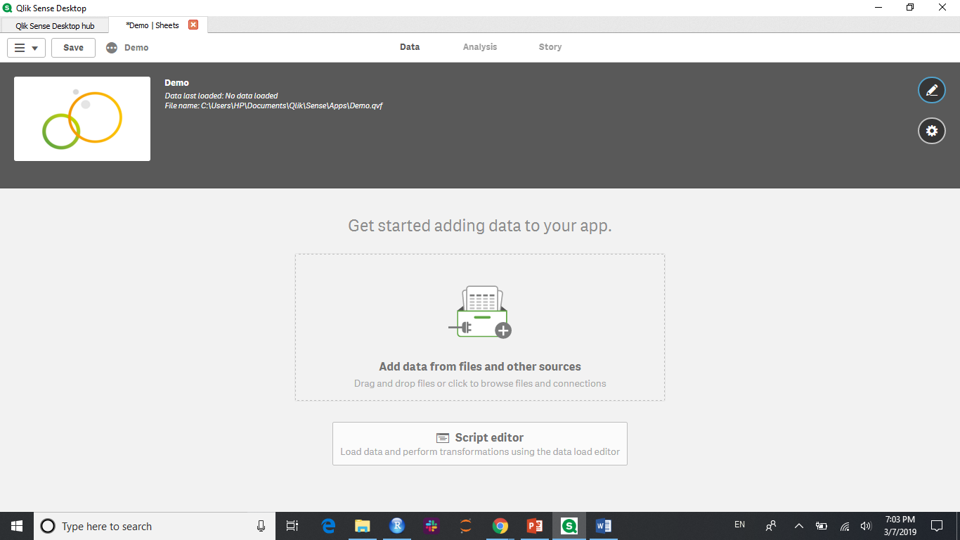

Slide 7
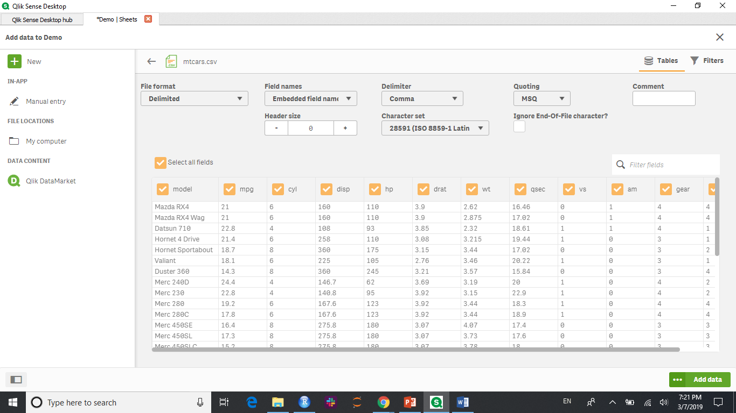

Slide 8
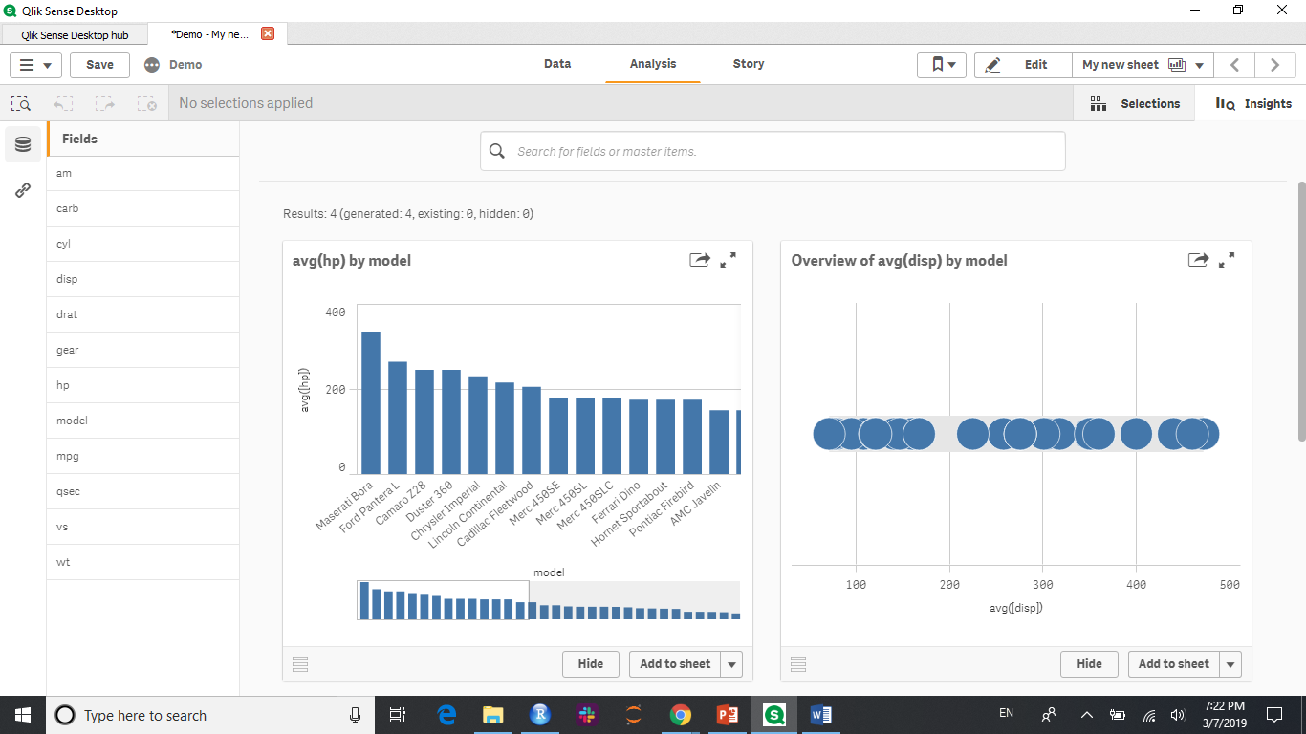

Slide 9
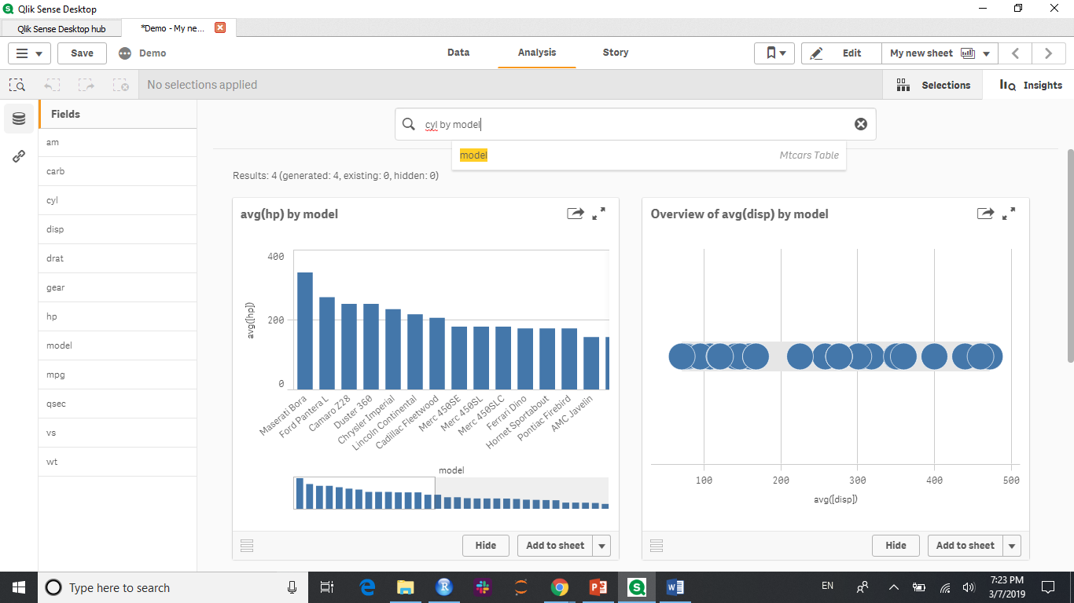

Slide 10
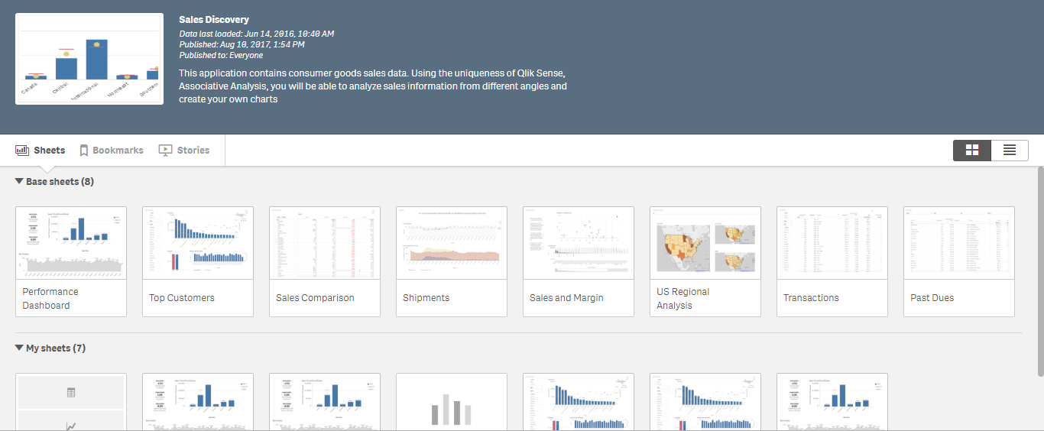

Slide 11
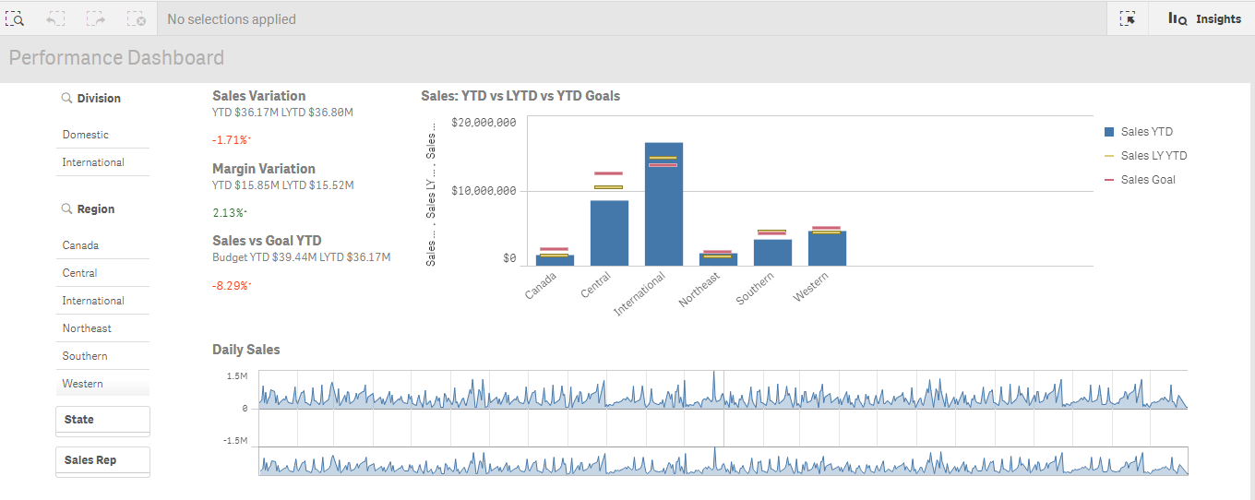

Slide 12
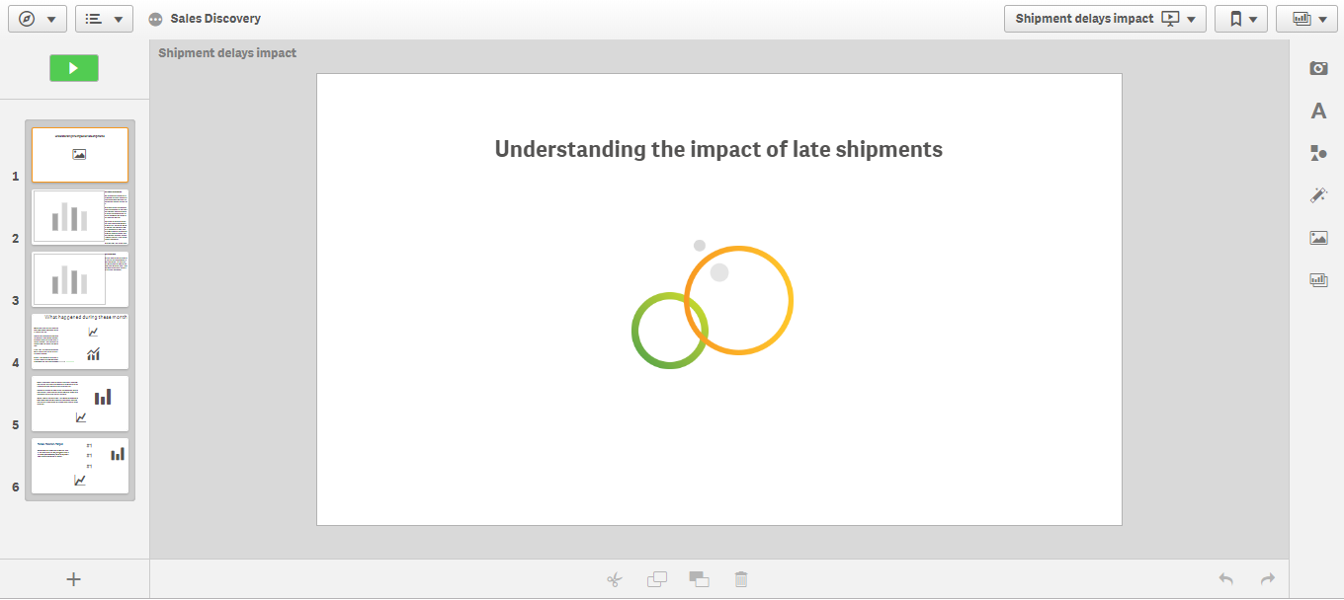

Slide 13
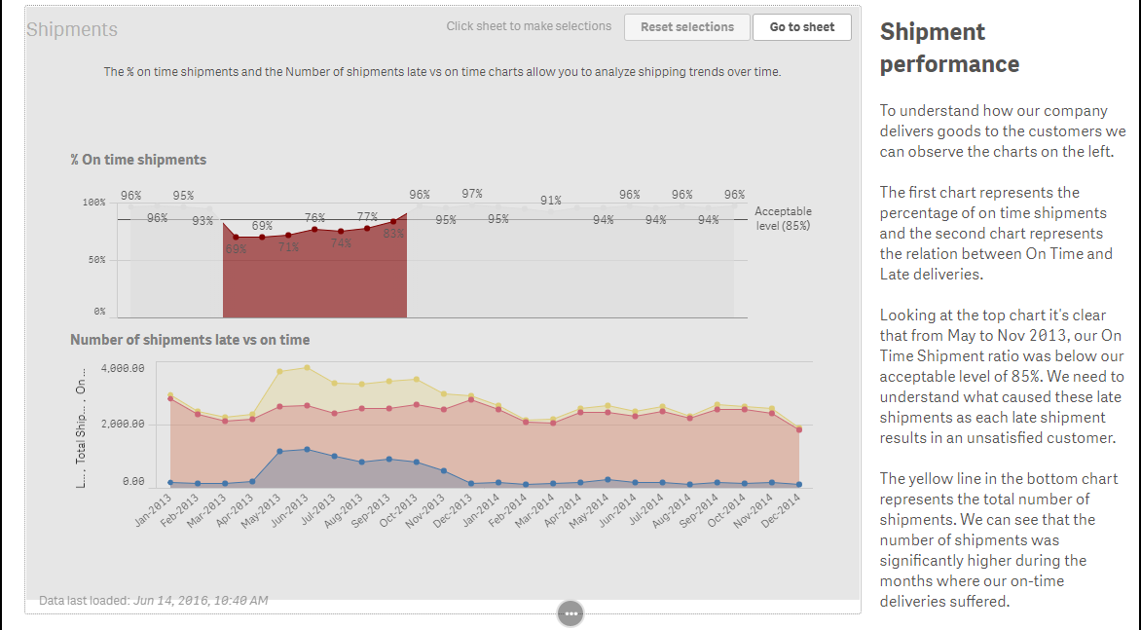

Slide 14
Summary
User friendly
All plots are tabulated in your working screen and you just need to find the plots which show the answer/story
Better than ggplot2?

Slide 15
Reference
https://stats.stackexchange.com/questions/263771/rshiny-vs-qlikview-vs-sap-lumira
https://www.qlik.com/us/products/qlik-sense
https://www.youtube.com/watch?v=xua3ahyWRdA&t=1411s

